Slide 1

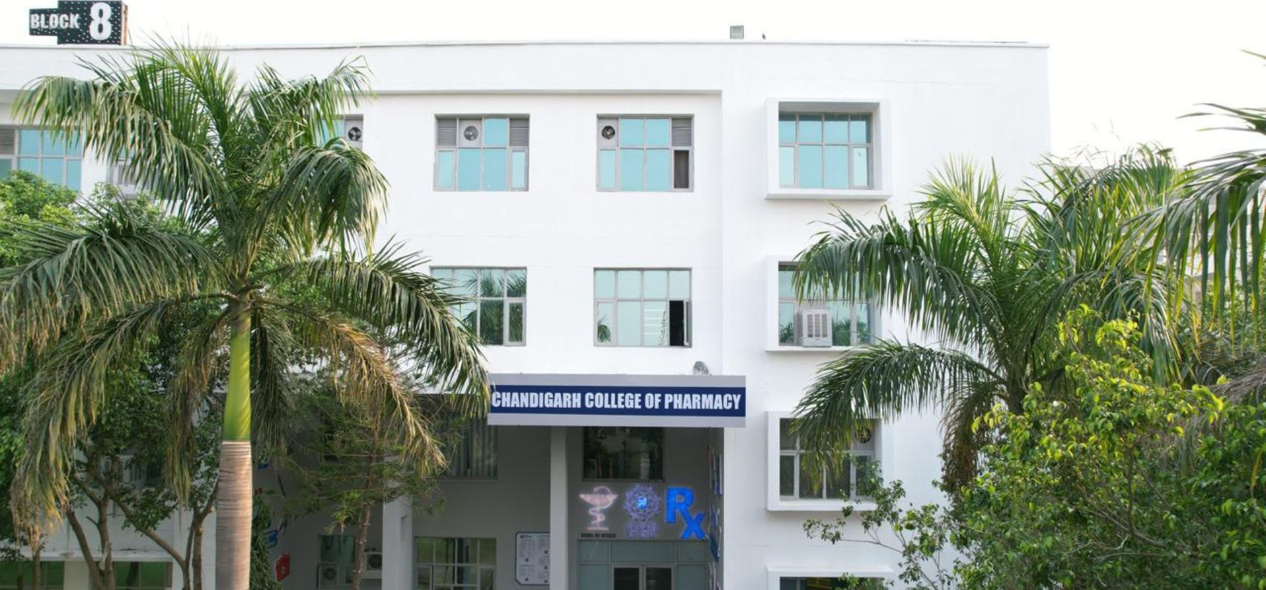

Slide 2
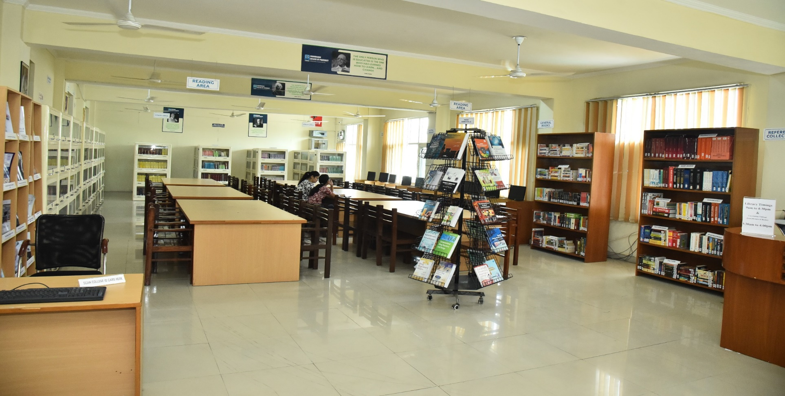
The online library provides live access to CHANDIGARH COLLEGE OF PHARMACY LIBRARY Collection on institution website http://ccpmohali.org Students and Faculty can get online information about Books/CD’s/E Books/ Journals/ E journals dealing with various subjects. Library works on LIBSYS software. CCP Library has 2 CCTV’s cameras to keep a close watch on the users so as to minimize the losses and mutilation of reading material.

Slide 3
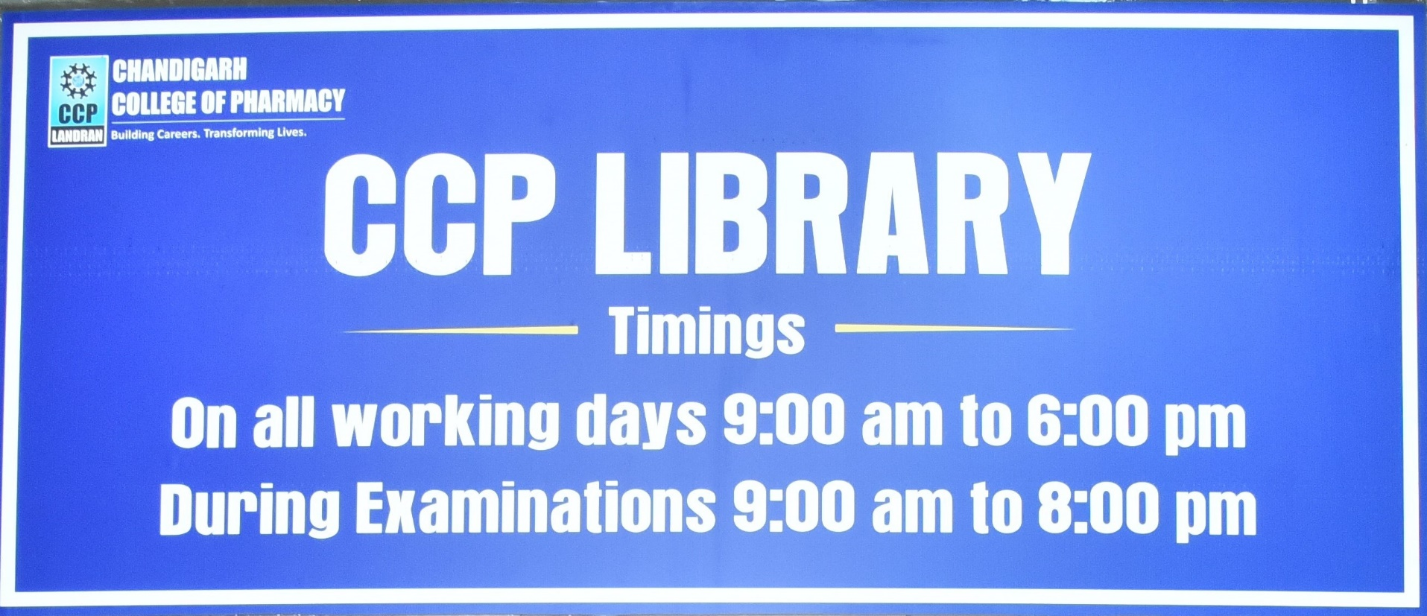

Slide 4
MISSION
The College Libraries are to sustain a physically and virtually appealing environment that promotes learning, teaching and research. It fosters lifelong intellectual growth and self-fulfilment by providing all users with versatile accessibility of the needed information resources. It also stimulates to promote individual sharing of ideas and love of reading and social enlightenment, enrichment throughout the knowledge society. It also supports in excellence and innovation in education and research.

Slide 5
OBJECTIVES
1) To establish a readers’ community to strengthen the goals.
2)To organize orientation programmes for users to keep them aware of the information society.
3) To promote the values and skills amongst the students.
4)To maintain a balanced and organized collection of high-quality materials and provide professional assistance to all users.
5) To provide access to information located elsewhere.
6)To educate users in developing information-gathering skills, including accessing, evaluating, and using various information sources.
7)To promote technological competence by providing access to information available in non-print formats.

Slide 6
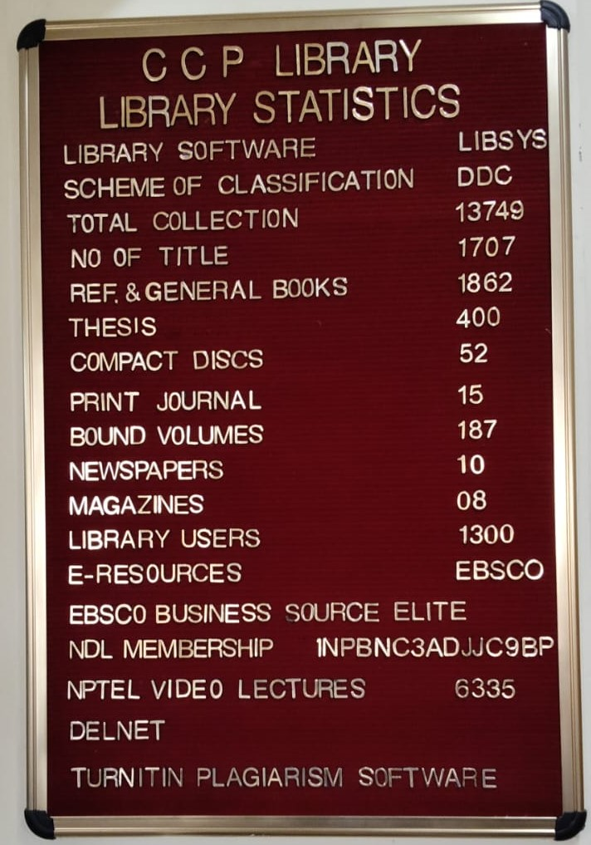
LIBRARY AT A GLANCE

Slide 7
CCP LIBRARY
TOTAL MEMBERSHIP
1300
DAILY FOOTFALL
100
DAILY TRANSACTIONS
50

Slide 8
LIBRARY STAFF
NAME | DESIGNATION
RENU OBEROI | CHIEF LIBRARIAN
RAVNEET KAUR | LIBRARIAN
SWARN SINGH | LIBRARY ASSISTANT
SHARANJIT KAUR | LIBRARY RESTORER

Slide 9
LIBRARY COMMITTEE
NAMES OF FACULTY/STAFF | DESIGNATION
Prof. Rupinder Sodhi, Director Principal, CCP | Chairman
Mrs. Renu Oberoi, Chief Librarian | Member Secretary
Dr. Supriya Agnihotri HOD-CCP | Member
Dr. Anjoo Kamboj Professor | Member
Dr. Komal Saini Associate Professor | Member
Dr. Priyanka Dhiman Associate Professor | Member
Ms. Reema Mitra Associate Professor | Member
Ms. Monika Sharma Associate Professor | Member
Ms.Ritika Kalia Assistant professor | Member

Slide 10

COLLEGE WEBSITE http://ccpmohali.org/
LIBRARY SOFTWARE
LIBSYS

Slide 11
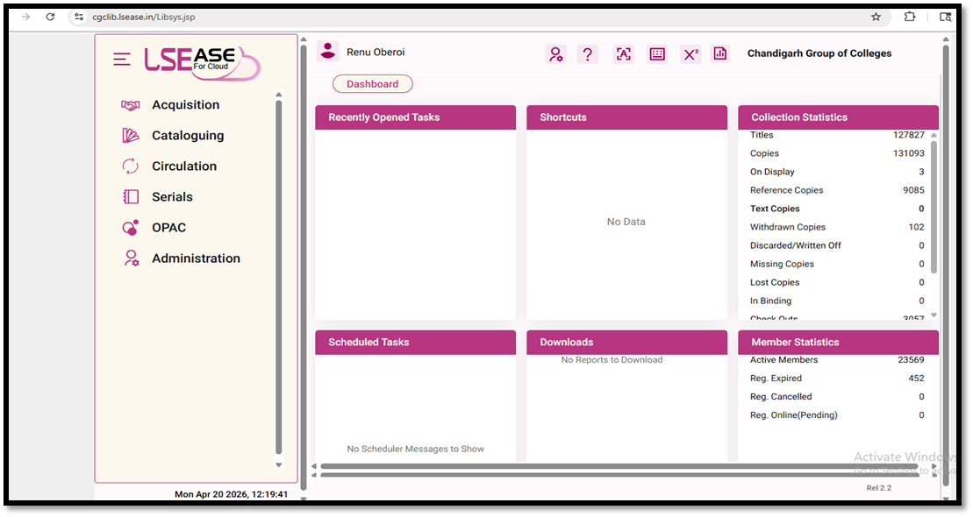
LIBRARY AUTOMATION USING INTEGRATED LIBRARY MANAGEMENT SYSTEM (ILMS)
LIBRARY SOFTWARE INTERFACE
Works on Cloud
URL : http://cgclib.lsease.in/
WEBOPAC with Remote Access
URL : http://cgcopac.lsease.in/

Slide 12
LOCATE YOUR BOOK(S)
“HOW TO USE WEB OPAC”
STEP 1 : SEARCH ON CGC WEBSITES:- www.cgc.edu.in OR ccpmohali.org .
STEP 2 : CLICK ON ONLINE LIBRARY OR LIBRARY.
STEP 3 : IN THE SEARCH BAR :
SEARCH BY AUTHOR (SURNAME/FIRST NAME)
SEARCH BY TITLE (DON’T USE A, AN, THE)
SEARCH BY KEYWORD
STEP 4 : SELECT THE BOOK OF YOUR CHOICE FROM YOUR CONCERNED LIBRARY ON
THE RIGHT-HAND SIDE FIELD (i.e., ALL) AND “GO”.
STEP 5 : SELECT BROWSE: TO KNOW ABOUT COLLECTION BY AUTHOR, TITLE,
CLASSIFIED, SUBJECT, PUBLISHER, PLACE.
STEP 6 : SELECT MY ACCOUNT: TO KNOW ABOUT THE BOOKS YOU HAVE
FACULTY WILL ENTER EMPLOYEE CODE AS USER ID & STUDENTS WILL
ENTER ROLL NO. AS USER ID.
PASSWORD IS SAME FOR ALL “cgclib”.
AFTER LOGGING IN EVERYONE HAS THE OPTION TO CHANGE THEIR
PASSWORD.
NOTE : DO NOT CLOSE THE WINDOW AFTER USE

Slide 13


Slide 14

E RESOURCES
Number of e-books (WORLD E-BOOK LIBRARY) 16809
Number of e-books (EBSCO) 29679
NDL Membership Yes
Number of e-journals(DELNET) 728
Total Number of e-journals(EBSCO) 1996
EBSCO Business Elite 1056
NPTEL VIDEO LECTURES 6335
CDs ( of Books and Magazines) 52
TURNITIN Plagiarism Software

Slide 15

The library has subscription of DELNET database via link http://www.delnet.in since the year 2019 and is subscribing 728 e-journals and 16809 e-books through World e-book library via link http://database.worldlibrary.org/

Slide 16
EBSCO’S Business Source Elite
Journals indexed in WOS (approx.) | Journals indexed in Scopus (approx.) |  | Indexed in ABDC Journal Quality List (approx.)
225 | 282 |  | 212
Journals and Magazines |  | 1056 full text journals
Case studies |  | More than 900
Company Profiles |  | More than 15,000
Videos |  | Nearly 75,000 videos from Associated Press
Market Research Reports |  | 2400
Regional Business News |  | 80 regional business publications are covered in Regional Business News
Industry Reports |  | 8700
SWOT Analyses |  | More than 5000 SWOT analyses are indexed where only metadata is available
Financial Reports |  | 42
Conference Proceedings & Conference Papers |  | 150

Slide 17

EBSCO DATABASE
EBSCO resources can also be remotely accessed on EBSCO App. or on the link http://search.ebscohost.com.
It provides scholarly 1996 Pharmacy e-journals, working papers, reports, datasets, and millions of digitized historical primary sources, including 2,65,000 e-books.

Slide 18

ANTI-PLAGIARISM SOFTWARE
To promote and support the research activities, CCP -CGC as a remedial measure has provided access to anti-plagiarism software TURNITIN since 2020.It is one such software, which is being successfully used at the global level to cross-check a vast database for identifying plagiarized portions in one’s research.

Slide 19

Lakhs of e-books can be accessed through NDL via link http://ndl.iitkgp.ac.in//.
INSTITUTIONAL NDL MEMBERSHIP NUMBER :INPBNC3ADJJC9BP

Slide 20

NPTEL Video lectures
Streamwise NPTEL
---- 6335 video lectures can be accessed via website https://archive.nptel.ac.in/

Slide 21
NPTEL VIDEO LECTURES: CCP LIBRARY
1 | NPTEL Anatomy (Video Lectures: 41) | https://www.digimat.in/nptel/courses/medical/anatomy/AN11.html | 329
2 | NPTEL VIDEO LECTURES Chemistry and biochemistry (Video Lectures: 107) | https://www.digimat.in/keyword/104.html | 4737
3 | NPTEL Biochemistry (Video Lectures: 53) | https://www.digimat.in/nptel/courses/medical/biochemistry/BC11.html | 403
4 | NPTEL Microbiology (Video Lectures: 58) | https://www.digimat.in/nptel/courses/medical/microbiology/MB11.html | 297
5 | NPTEL Pathology (Video Lectures: 47) | https://www.digimat.in/nptel/courses/medical/pathology/PA11.html | 189
6 | NPTEL Pharmacology (Video Lectures: 34) | https://www.digimat.in/nptel/courses/medical/pharmacology/PH11.html | 203
7 | NPTEL Physiology (Video Lectures: 33) | https://www.digimat.in/nptel/courses/medical/physiology/PY11.html | 177
8 | NPTEL NANOTECHNOLOGY (Video Lectures:2) | https://www.digimat.in/nptel/courses/video/118102003/L01.html | 85

Slide 22
E-RESOURCES : LOGIN CREDENTIALS WITH REMOTE ACCESS
DELNET : http://www.delnet.in
Click to New Discovery Portal
Login : pbccpm
Password : ccpm10088
2. World Library Access : http://database.worldlibrary.org/
Login:in_cgclm@user
Password: reading
3. EBSCO Business Source Elite : https://search.ebscohost.com/login.aspx?authtype=ip,uid&custid=ns154387&groupid=main&profile=ehost&defaultdb=bsh
User ID: chandigarhbusi
Password: Library@2025
4. EBSCO DATABASE : http://search.ebscohost.com
Login ID cgcl
Password clg@2025
5. NPTEL Video Lectures : https://archive.nptel.ac.in/
6. National Digital Library : https://ndl.iitkgp.ac.in/
7. TURNITIN PLAGIARISM SOFTWARE
8. LIBSYS WEBOPAC : https://cgcopac.lsease.in

Slide 24

Repository Links
1 e-PG Pathshala https://epgp.inflibnet.ac.in
2 e-Shodh Sindhu https://ess.inflibnet.ac.in
3 Search Engine for PDF Books www.pdfdrive.com
4 National Digital Library of India https://ndl.iitkgp.ac.in
5 ShodhGanga https://shodhganga.inflibnet.ac.in/
6 Discover scientific knowledge and stay connected to the world of science https://www.researchgate.net/
7 Free e books(60000+) https://www.gutenberg.org/
8 NPTEL [National Programme on Technology Enhanced Learning] https://nptel.ac.in
9 NPTEL Video Lectures https://archive.nptel.ac.in/

Slide 25
10 OASIS (Openly Available Sources Integrated Search) https://openlibrary.org/
11 Open access for academic books https://www.oapen.org/
12 SAKSHAT https://sakshat.ac.in/?project=vidwan
13 Open Access books https://www.doabooks.org/
14 SWAYAMPRABHA https://www.swayamprabha.gov.in
15 SWAYAM Online Courses https://storage.googleapis.com/uniquecourses/online.html
16 Enhancement in Learning with Improvement in Skills (ELIS) portal http://free.aicte-india.org/
17 DOAB - Directory of Open Access Books https://directory.doabooks.org/handle/20.500.12854/34495

Slide 26
18 DOAJ https://doaj.org/
19 e-Content courseware in UG subjects http://cec.nic.in/cec/
20 E-Kalpa https://icar.org.in/content/e-kalpa
21 Open Access Books and Journals https://about.jstor.org/librarians/books/open-access-books-jstor/
22 Free e-Books https://www.gutenberg.org/
23 AICTE Collaborations (MoU) with other Organizations https://www.aicte-india.org/education/collaborations
24 AAKASH EDUCATIONAL PORTAL https://www.it.iitb.ac.in/nmeict/home.html
25 InfoPort https:/infoport.inflibnet.ac.in
26 OAPEN https://www.oapen.org/

Slide 27
27 QUANTUM & NANO COMPUTING https://www.dei.ac.in/dei/quantumNano/
28 The Online Books Page https://onlinebooks.library.upenn.edu/lists.html
29 SNLTR https://nltr.org
30 EThOS https://ethos.bl.uk/Home.do
31 DART-Europe E-theses Portal https://www.dart-europe.org/basic-search.php
32 Virtual Labs http://www.vlab.co.in/
33 YOUTH4WORK https://www.youth4work.com/onlinetalenttest
34 Theses https://library-archives.canada.ca/eng
35 Gateway Accelerating Scientific Discovery https://worldwidescience.org/
36 DIGITAL LIBRARY INFLIBNET https://ess.inflibnet.ac.in/

Slide 28
37 Digital Commons Network https://irsc.libguides.com
38 FOSSEE https://fossee.in
39 Study IQ Education www.youtube.com
40 UG/PG MOOCs http://ugcmoocs.intlibnet.ac.in/ugemoocs
41 E-Books and E-Journals https://www.socsccybraryamu.ac.in/
42 CEC-UGC YouTube Channel https://www.youtube.com/user/cecedusat
43 TCSION Digital Glass Room https://learning.tcsionhub.in/hub/glass-room/
44 ERIC https://eric.ed.gov/
45 Free e-Databases http://www.globethics.net/

Slide 29

46 Free Journals http://www.archive.org
47 Spoken Tutorial https:/spoken-tutorial.org/
48 National Apprenticeship Training Scheme http://mhrdnats.gov.in/
49 E – Kumbh https://ekumbh.aicte-india.org/
50 E-BOOKS https://www.wikibooks.org/

Slide 30

e-Newspaper WEBSITES
http://www.tribuneindia.com
www.indianpress.org
www.hindustantimes.com
www.epaper.timesofindia.com
https://dailypost.in/#google_vignette
https://epaper.jagbani.com/
http://economictimes.indiatimes.com
http://epaper.amarujala.com
https://epaper.jagran.com/epaper/
http://epaper.punjabkesari.in
http://jagbani.epapr.in
http://epaper.ajitjalandhar.com
http://www.rozanaspokesman.com/epaper/

Slide 31

FREE E-MAGAZINE WEBSITES https://worldmags.net/ https://fliphtml5.com/ https://www.bisinfotech.com/bisinfotech-magazine https://pdf-magazines.org/ https://all-freemagazines.com/ https://downmagaz.net/ https://www.pdfmagaz.club/ https://magazinenewsstand.com/digital-magazines https://pdf-magazines-download.com/ https://openthemagazine.com/

Slide 32

FACILITIES PROVIDED BY LIBRARY

Slide 33
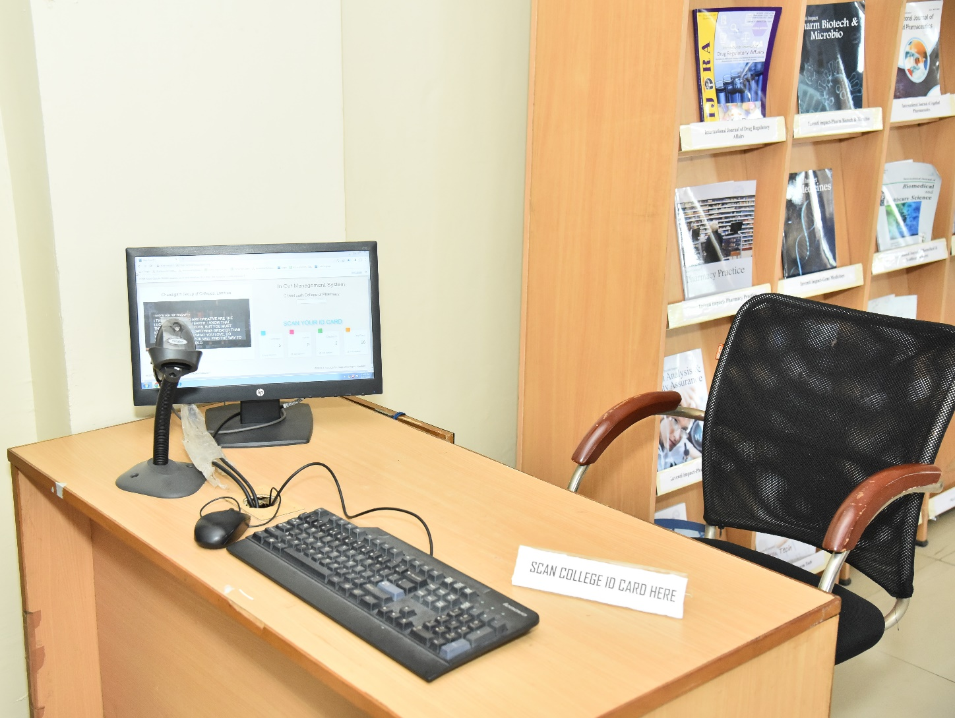
BARCODE SCANNED ENTRY/EXIT
Since the ID cards are scanned to keep track of entry and exit, foot traffic in the library is computerized. Students scan their ID cards as they enter or leave the library using the barcode scanner

Slide 34
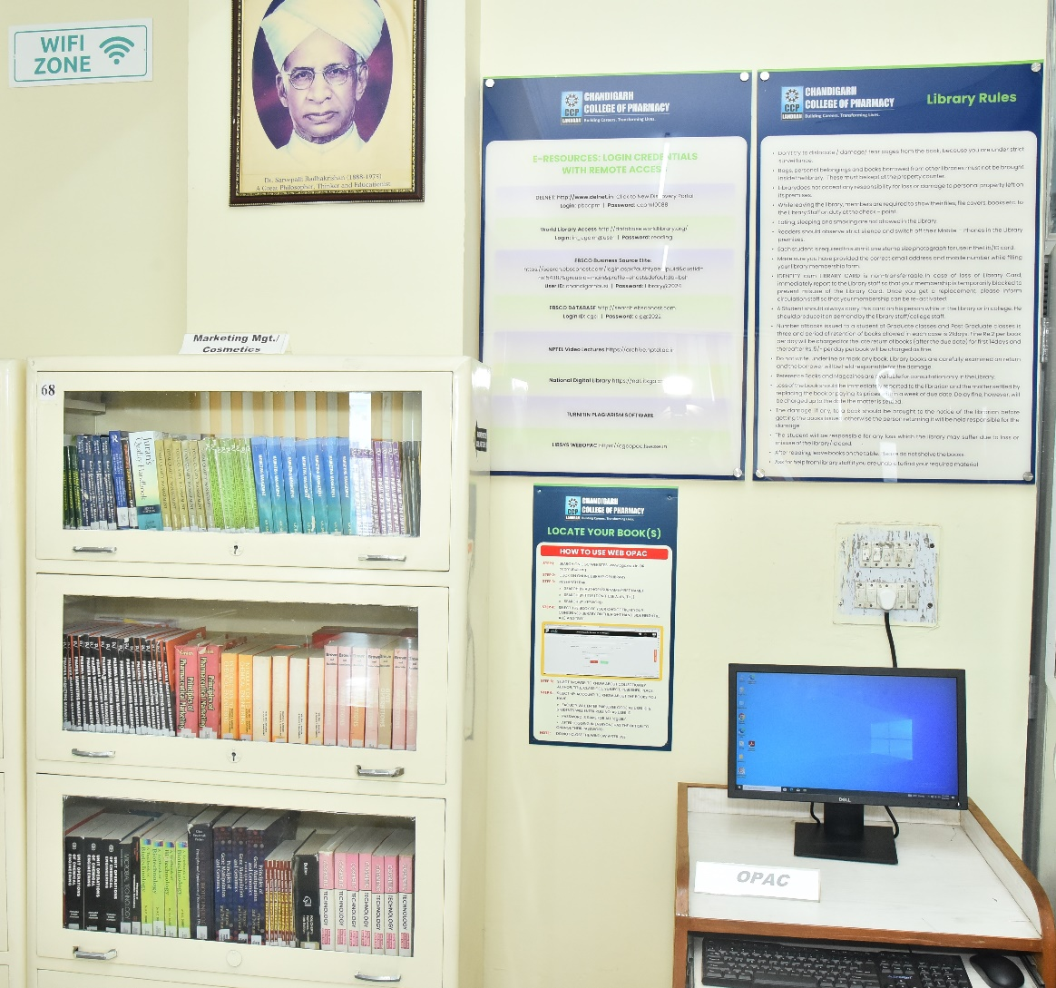
ONLINE CATALOGUE (OPAC)
The facility to search the open public access catalogue (OPAC) is open to all the users over the campus-wide LAN at the URL: https://cgcopac.lsease.in/. 1 pc in library is exclusively dedicated to OPAC search to facilitate the users.

Slide 35
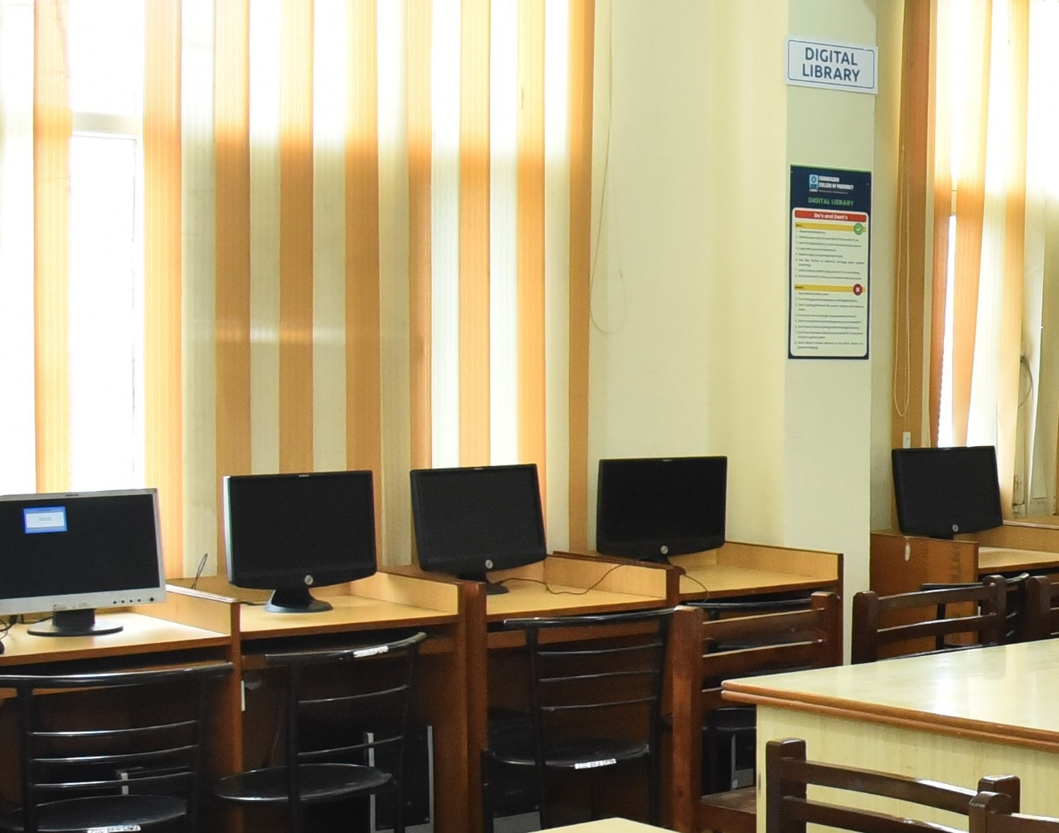
DIGITAL LIBRARY
THE LIBRARY INTENDS TO HAVE A WELL-DEVELOPED COMPUTER AND NETWORK INFRASTRUCTURE IN THE FORM OF A DIGITAL LIBRARY WITH A PROVISION OF 10 COMPUTERS TO FACILITATE THE USE OF ALL THE WEB-BASED RESOURCES AND E SERVICES SUBSCRIBED.

Slide 36
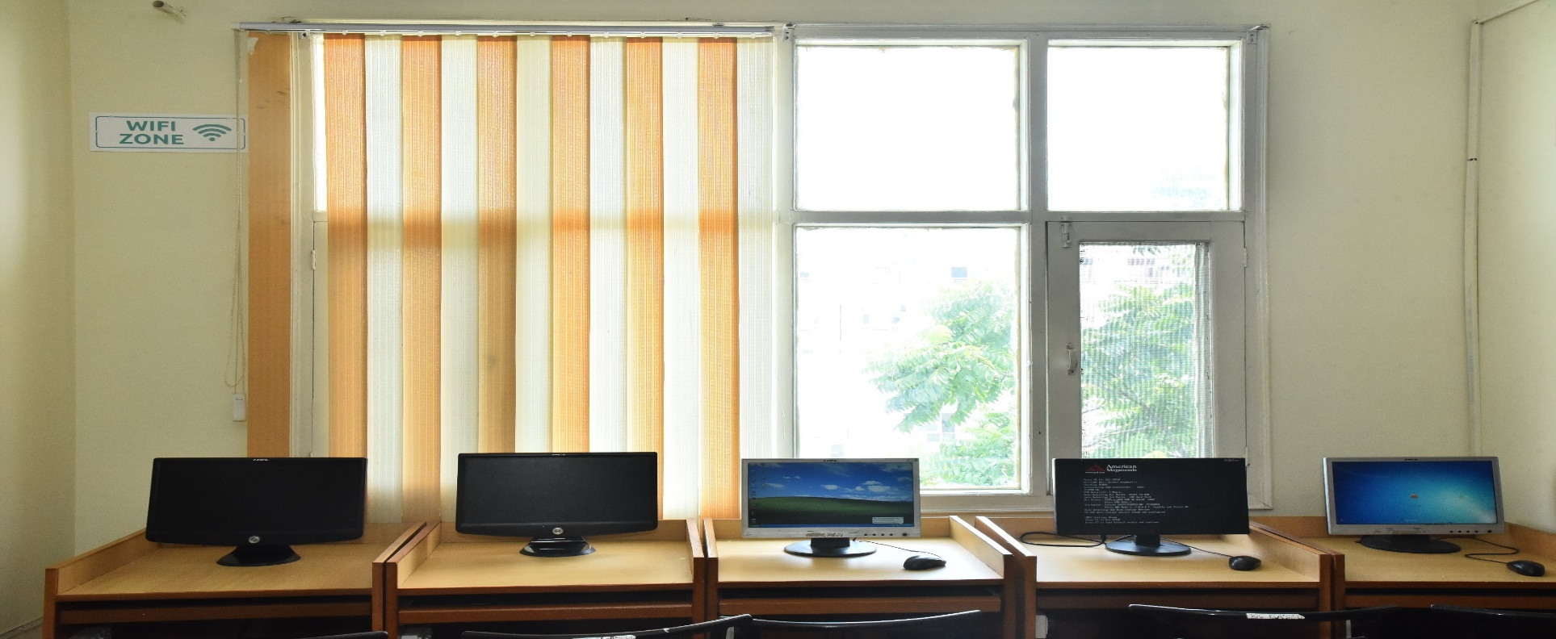
WI-FI FACILITY
STUDENTS & FACULTY CAN ACCESS THE INTERNET WITHIN LIBRARY PREMISES ON THEIR LAPTOPS AND MOBILES, AS THE LIBRARIES ARE WI-FI ENABLED.

Slide 37
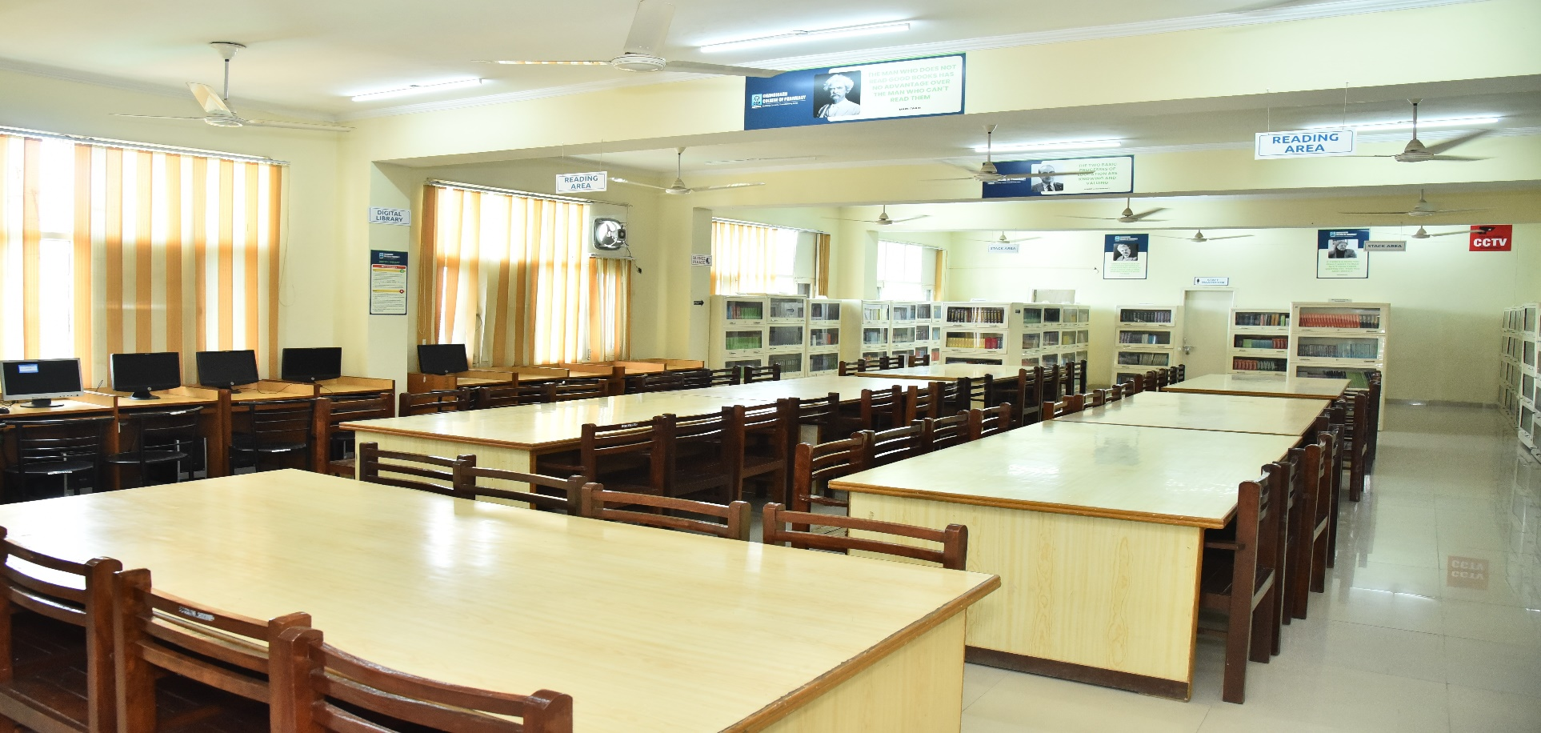
READING HALL FACILITY
The library provide its users with a conducive atmosphere with ample seating capacity.

Slide 38
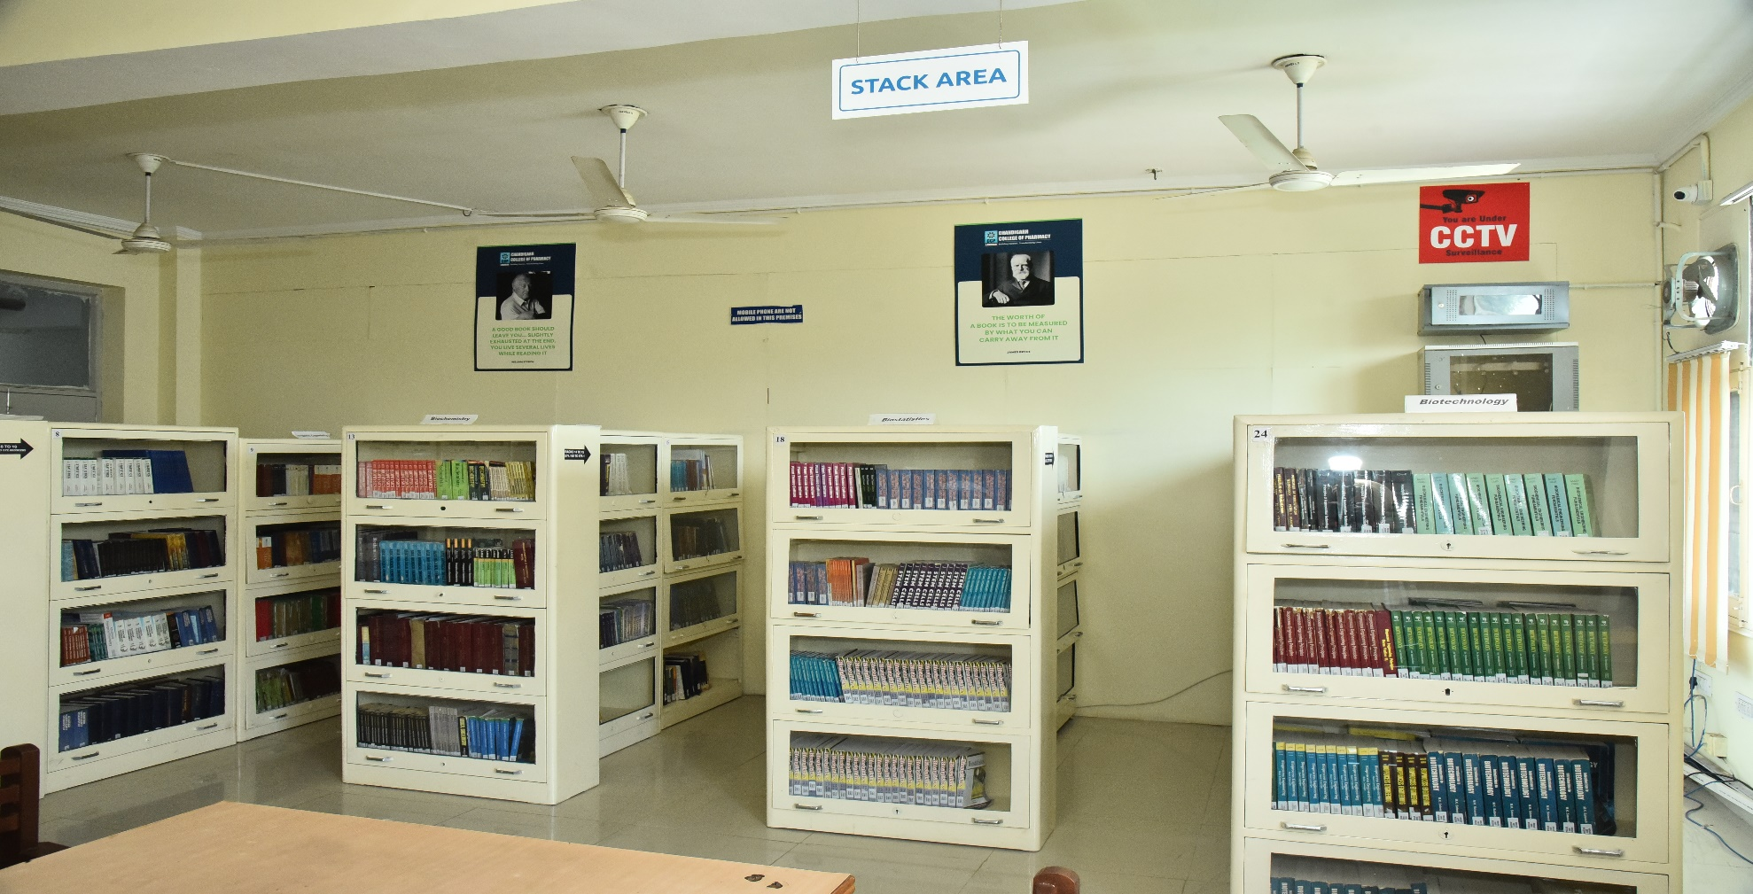
24hr. Surveillance
2 CCTVs are installed in CCP Library

Slide 39
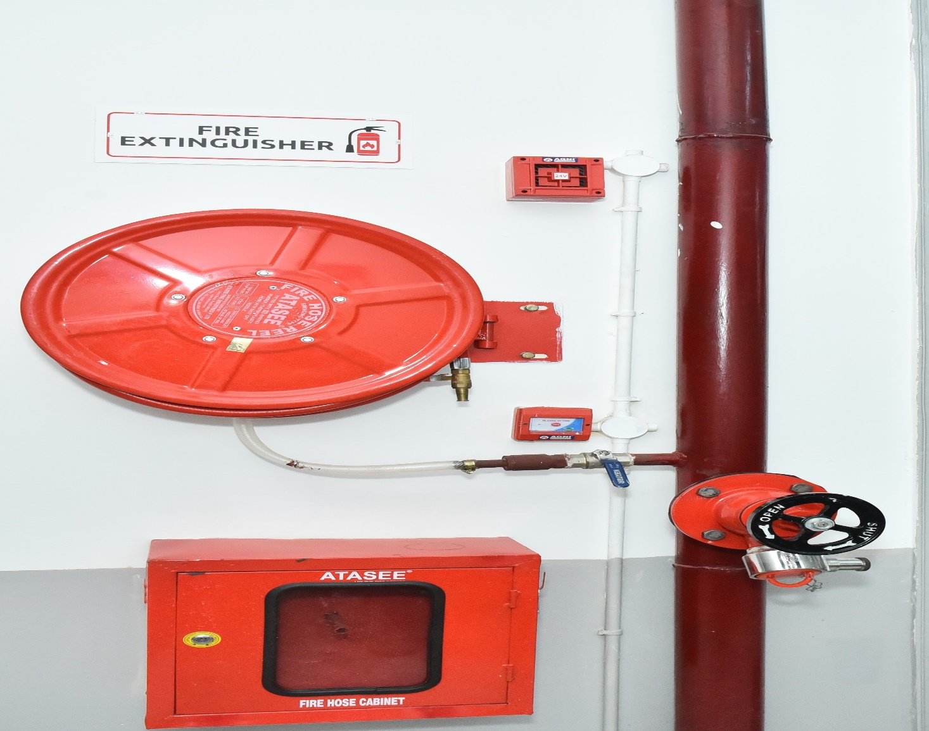
FIRE SAFETY EQUIPMENT

Slide 40
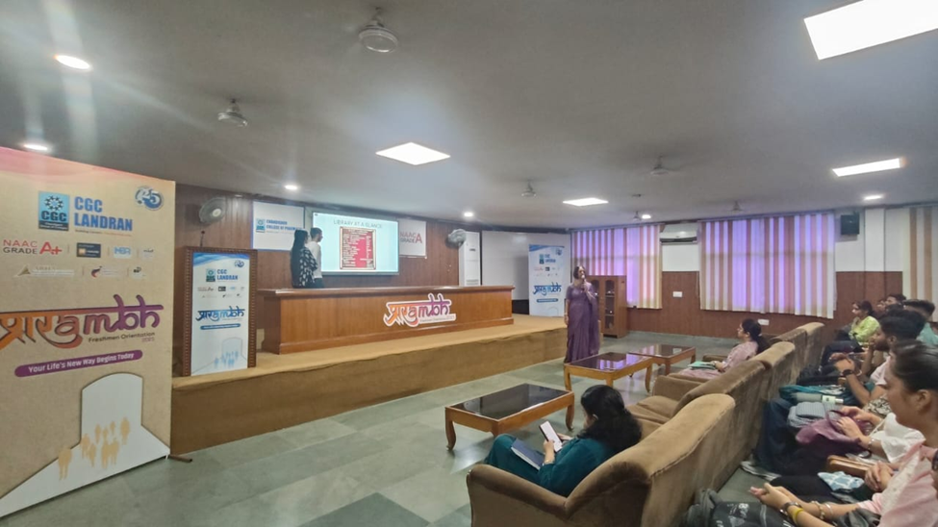
INDUCTION PROGRAMME FOR FRESHERS (SESSION 2025-26)

Slide 41
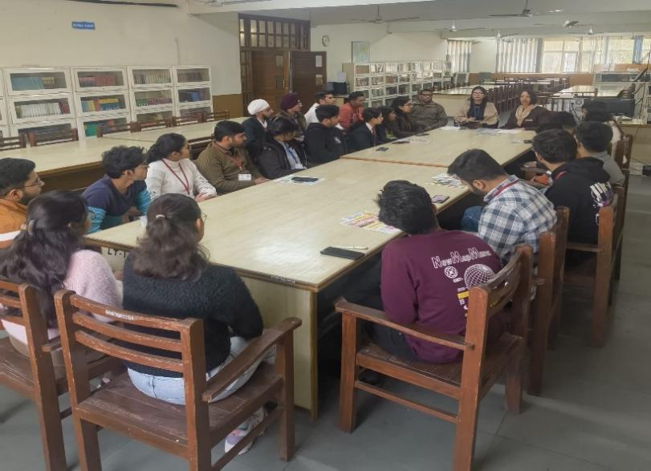
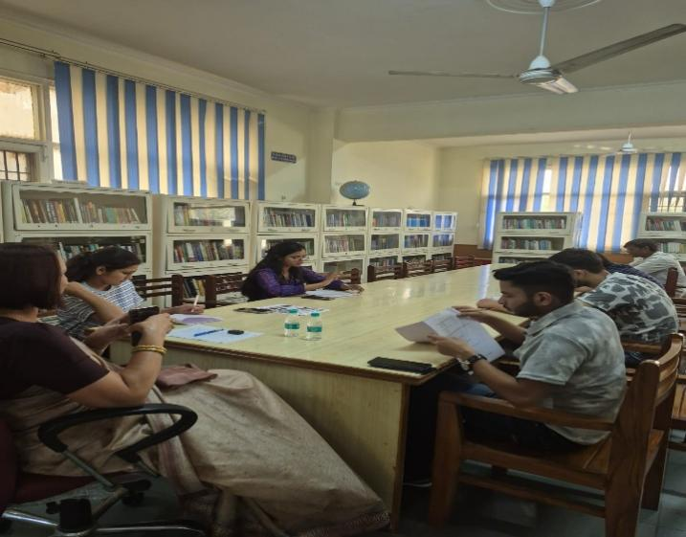
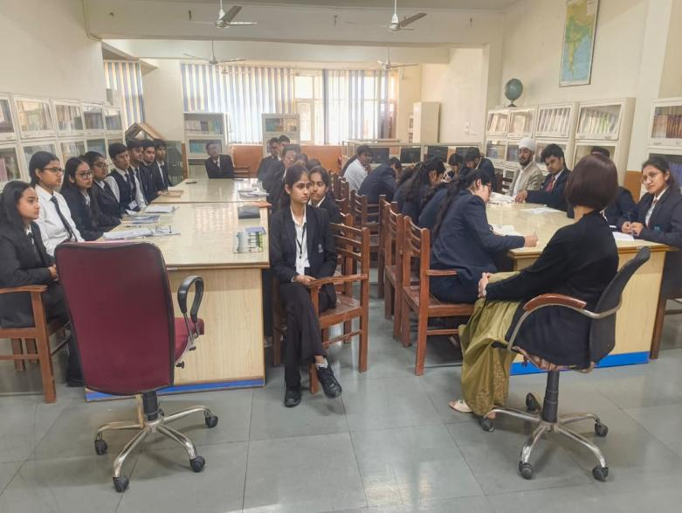
Breaking the Ice – 1ST Meeting 30th January 2026
Quiz Contest – 3rd Meeting
1st April 2026
Book Review Session – 2nd Meeting
17th February 2026

Slide 42
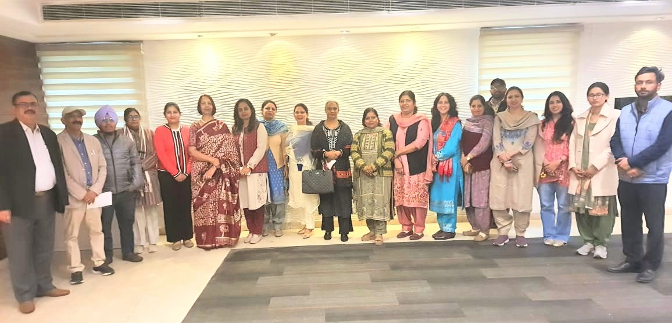
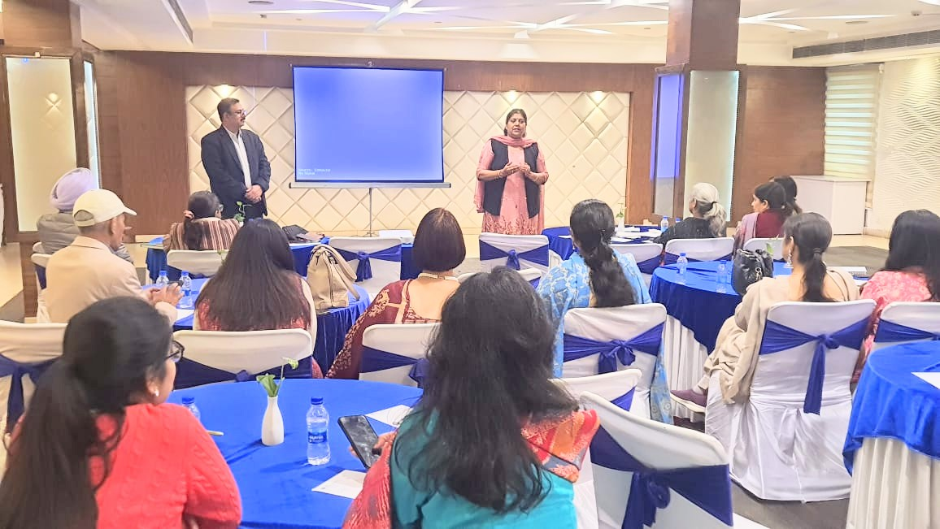
LIBSYS WORKSHOP
SHIVALIK VIEW CHANDIGARH
ON
18TH FEB 2026

Slide 43

DIFFERENT SECTIONS OF LIBRARY
ENTRY/EXIT GATE
PROPERTY COUNTER
WEBOPAC SECTION
ACQUISITION SECTION
TECHNICAL SECTION
REFERENCE SECTION
CIRCULATION SECTION
PERIODICAL SECTION
BOUND VOLUMES SECTION
DIGITAL LIBRARY SECTION
REPROGRAPHIC SECTION
DISSERTATION /THESIS SECTION

Slide 44
ACQUISITION SECTION
NO.OF TITLES/VOLUMES ADDED LAST 5 YEARS GROWTH
SESSION | ACCESSION NUMBER | TOTAL NO. OF TITLES | TOTAL NO. OF VOLUMES | EXPENDITURE IN RS.
2021-22 | 11299-11568 | 89 | 255 | 4,53,639
2022-23 | 11569-13000 | 97 | 801 | 3,98,107
2023-24 | 13000-13296 | 61 | 296 | 1,91,505
2024-25 | 13297-13593 | 39 | 296 | 1,99,450
2025-26 | 13594-13749 | 39 | 156 | 3,22,831

Slide 45
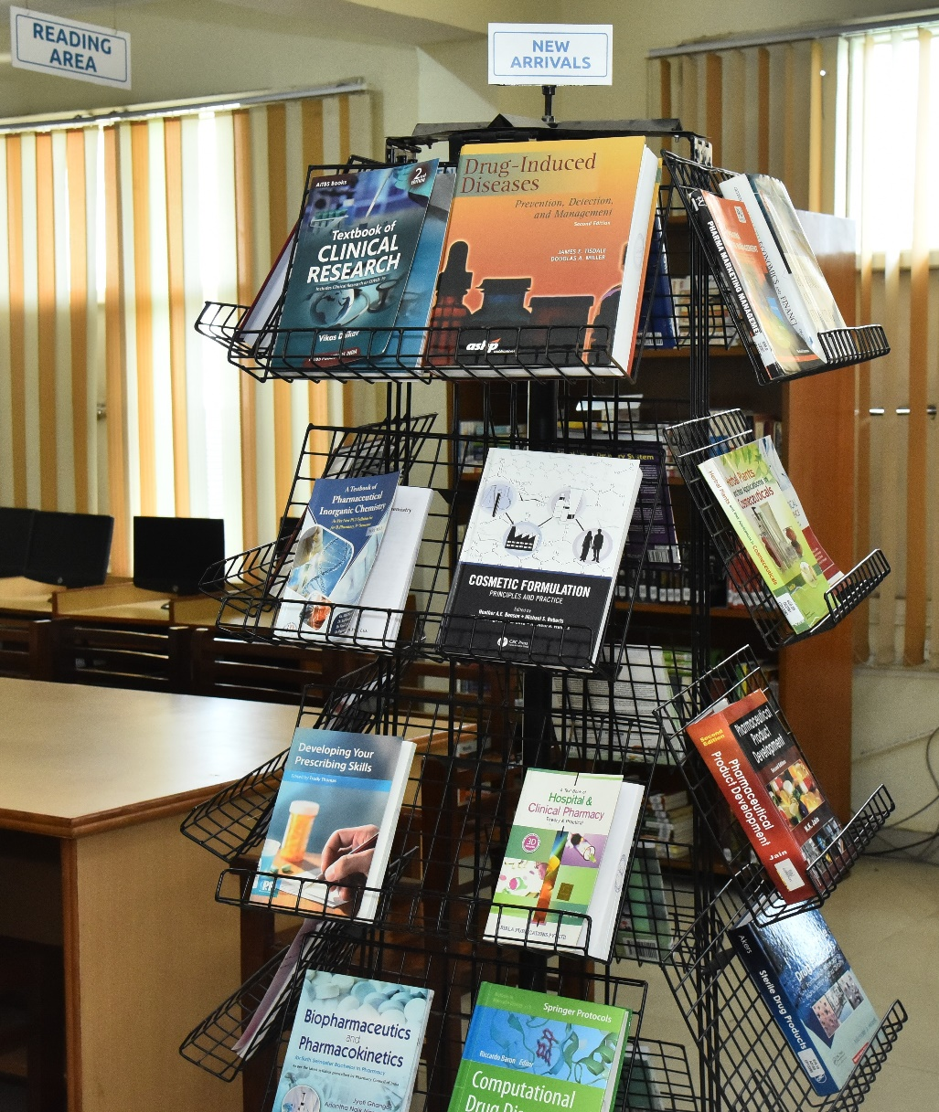
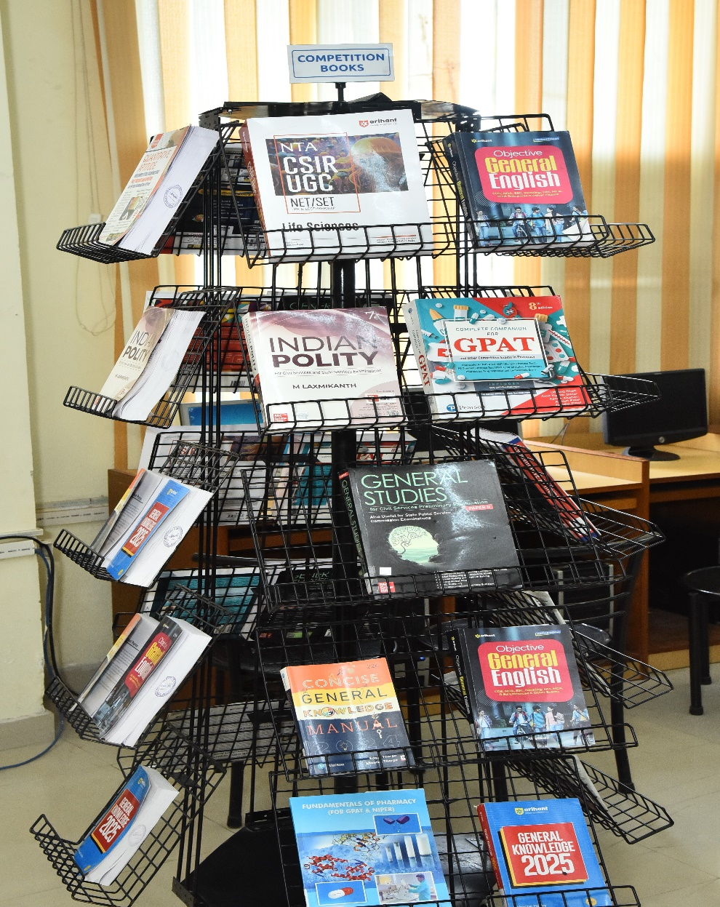
DISPLAY OF NEW ARRIVALS

Slide 46
CCP LIBRARY – NEW ARRIVALS YEAR 2025-26
Acc No | Call no. | Author | 39 TITLES | Copies
CP13594-CP13600 | 615 P653T | PINGALE, PRASHANT L. | TEXTBOOK ON INDUSTRIAL PHARMACY (VOL II) | 7
CP13601-CP13610 | 610.72 S556T | SHINKAR, DATTATRAYA M. | TEXTBOOK OF BIOSTATISTICS AND RESEARCH METHODOLOGY | 10
CP13611-CP13615 | 574.192 S966M | SUTHAKARAN, R. | MEDICINAL BIOCHEMISTRY FOR PHARMA D | 5
CP13616-CP13620 | 615.19 I27M | ILANGO, K. | MEDICINAL CHEMISTRY FOR PHARMA D | 5
CP13621 | 615.6 R658C | ROBINSON, JOSEPH R. | CONTROLLED DRUG DELIVERY FUNDAMENTALS AND APPLICATIONS | 1
CP13622-CP13624 | 001.42 P194R | PANNEERSELVAM,R. | RESEARCH METHODOLOGY | 3
CP13625-CP13626 | 615 K527T | KHAR, ROOP, K. | THEORY AND PRACTICE OF INDUSTRIAL PHARMACY | 2
CP13627-CP13628 | 615.4 W337 | WATSON, JENNIE | PHARMACY PRACTICE | 2
CP13629-CP13638 | 615.1 T738E | TRIPATHI,K.D. | ESSENTIALS OF MEDICAL PHARMACOLOGY | 10
CP13639 | 615.11 S921T | STROM, BRIAN | TEXTBOOK OF PHARMACOEPIDEMIOLOGY | 1
CP13640-Cp13641 | 547.346 P289I | PAVIA, DONALD P. | INTRODUCTION TO SPECTROSCOPY | 2

Slide 47
CP13642-CP13651 | 574 G563R | GOKHALE,S.B. | REMEDIAL BIOLOGY | 10
CP13652-CP13656 | 615.1 S562T | SHYAM,T. | TEXTBOOK OF PHARMACOGNOSY AND PHYTOPHARMACOLOGY | 5
CP13657 | 574.192 D494D | DEVI,SUSHMA | ROLE OF FREE RADICAL IN PATHOLOGY | 1
CP13658-CP13662 | 615.321 I26P | IKBAL,ANSARI | PHARMACOGNOSY AND PHYTOCHEMISTRY - II | 5
CP13663 | 615.19 A398R | ALI,JAVED | REGULATORY AFFAIRS IN THE PHARMACEUTICAL INDUSTRY | 1
CP13664-CP13666 | 615.19 V434R | VEINTRAMUTHU,SANKAR | REGULATORY AFFAIRS BASIC PROTOCOLS | 3
CP13667 | 615.7 J27B | JAMBHEKAR,SUNIL S. | BASIC PHARMACOKINECTICS | 1
CP13668-CP13670 | 610.72 S617M | SINGHAL, YOGESH K. | MAHAJAN'S METHODS IN BIOSTATISTICS FOR MEDICAL STUDENTS AND RESEARCH WORKERS | 3
CP13671-CP1376 | 615.6 V991T | VYAS, S.P. AND KHAR, R.K. | TARGETED AND CONTROLLED DRUG DELIVERY | 6
CP13677-CP13678 | 615.58 W36C | WHITTLESEA, CATE | CLINICAL PHARMCY AND THERAPEUTICS | 2
CP13679-CP13688 | 615.19 S23P | SHARMA, SHALINI | TEXTBOOK OF PHARMACEUTICS | 10
CP13689-CP13693 | 615.58 S415S | SCHWINGHAMMER, TERRY L. | SCHWINGHAMMER'S PHARMACOTHERAPY CASEBOOK: A PATIENT FOCUSED APPROACH | 5
CP13694-CP13698 | 615.321 M953Q | MUKHERJEE, PULOK K. | QUALITY CONTROL OF HERBAL DRUGS | 5
CP13699-CP13703 | 543.08 S23I | SHARMA, B. K. | INSTRUMENTAL METHODS OF CHEMICAL ANALYSIS : VOLUME 1 SPECTROSCOPY | 5
CP13704-CP13708 | 543.08 S23I | SHARMA, B.K. | INSTRUMENTAL METHODS OF CHEMICAL ANALYSIS VOLUME 2 CHROMATOGRAPHY AND MISCELLANEOUS METHODS | 5

Slide 48
CP13709-CP13718 | 616.01 M953T | MUJUMDER, PULOK AND SAHOO, SAMEER RANJAN | TEXTBOOK OF PHARMACEUTICAL MICROBIOLOGY | 10
CP13719 | 615.11 S921T | STROM, BRIAN | TEXTBOOK OF PHARMACOEPIDEMIOLOGY | 1
CP13720 | 615.1 B274C | BARRETT, JAMES E. | CONCEPTS AND PRINCIPLES OF PHARMACOLOGY | 1
CP13721 | 615.19 R556P | ROGGE, MARK C. | PRECLINICAL DRUG DEVELOPMENT | 1
CP13722 | 616.12 S17A | SREELATHA, HARIKRISHNAN VIJAYA | ANIMAL MODELS IN RESEARCH : PRINCIPLES AND PRACTICE | 1
CP13723 | 616.042 D614D | DISTEFANO, JOHANNA K. | DISEASE GENE IDENTIFICATION | 1
CP13724-CP13731 | 615.1 B171T | BALASUBRAMANIAN, S. | TEXTBOOK OF PHARMACY PRACTICE | 8
CP13732 | 615.58 S415D | SCHWINGHAMMER, TERRY L. | DIPIRO'S PHARMACOTHERAPY HANDBOOK | 1
CP13733-CP13736 | 615.115 I39 | GOVT OF INDIA | INDIAN PHARMACOPOEIA 2026 VOLUME I - IV | 4
CP13737-CP13746 | 615.19 K96T | KUMAR, K. RAVI | TEXTBOOK OF PHARMACEUTICAL INORGANIC CHEMISTRY | 10
CP13747 | 615.19 T944N | TURNER, J. RICK | NEW DRUG DEVELOPMENT: DESIGN, METHODOLOGY AND ANALYSIS | 1
CP13748 | 615.11 S921T | STROM, BRIAN | TEXTBOOK OF PHARMACOEPIDEMIOLOGY | 1
CP13749 | 615.58 S415D | SCHWINGHAMMER, TERRY L. | DIPIRO'S PHARMACOTHERAPY HANDBOOK | 1

Slide 49
NO. OF TILES WEEDED OUT /MISSING/PRICE PAID
YEAR | NO OF VOLUMES | WEEDED OUT /MISSING/PRICE PAID
2011 | 35 | Missing
2012 | 3 | Missing
2023 | 2300 | Weeded Out
2023 | 825 | Weeded Out
2023 | 46 | Missing
2007-25 | 27 | Price Paid

Slide 50
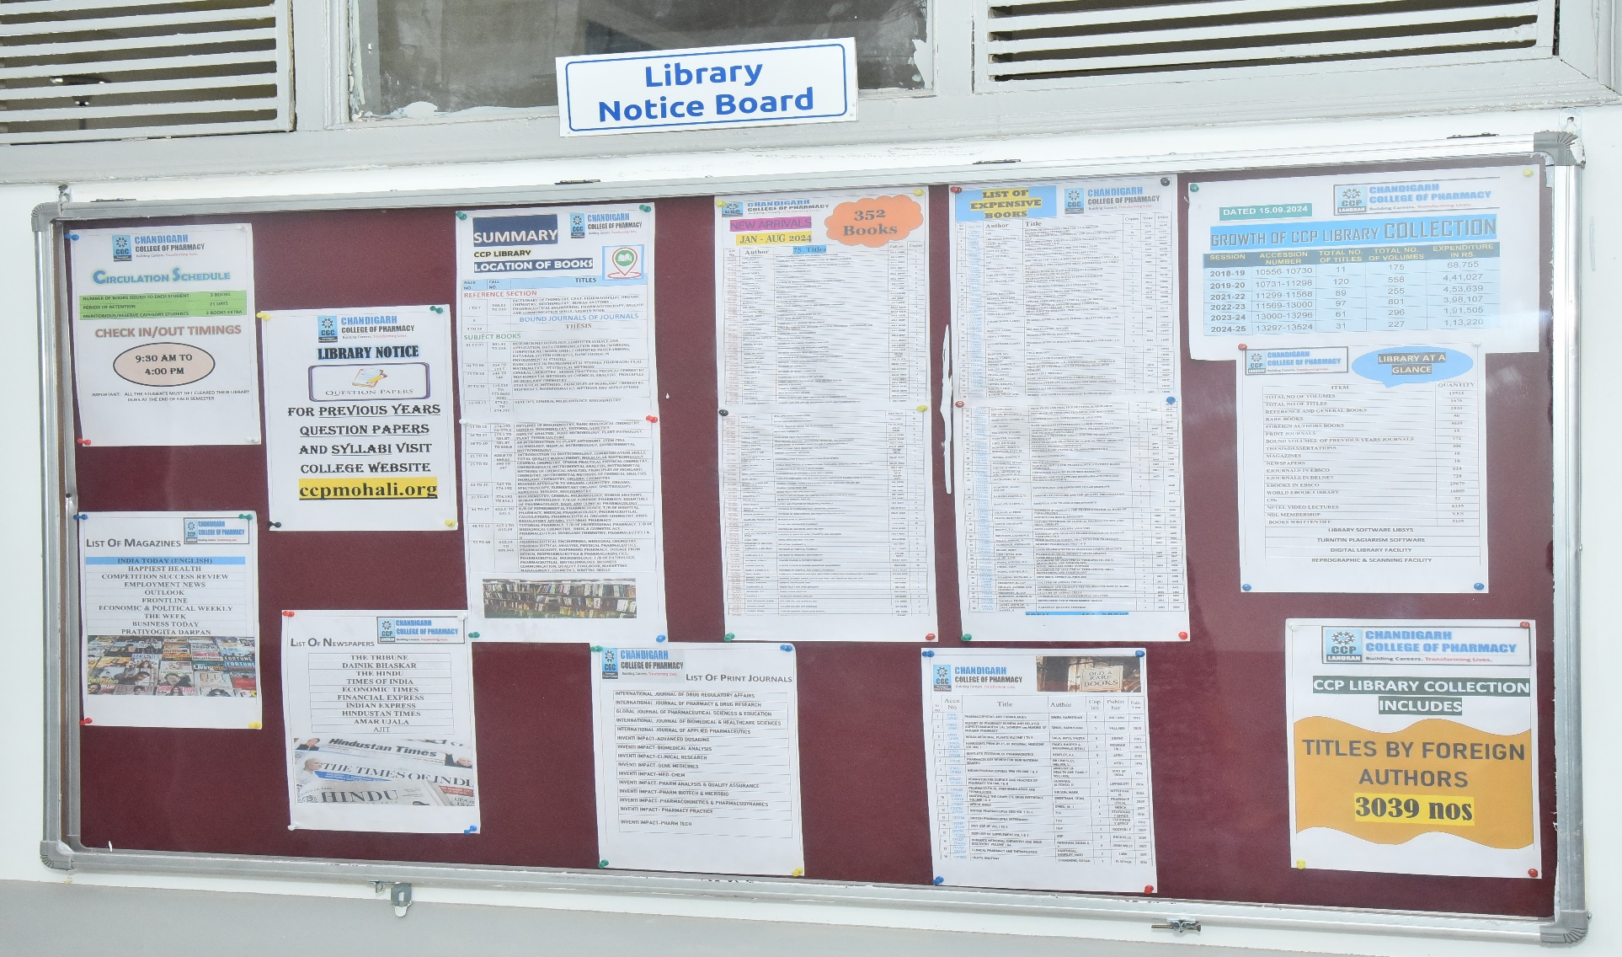
LIBRARY NOTICE BOARD

Slide 51
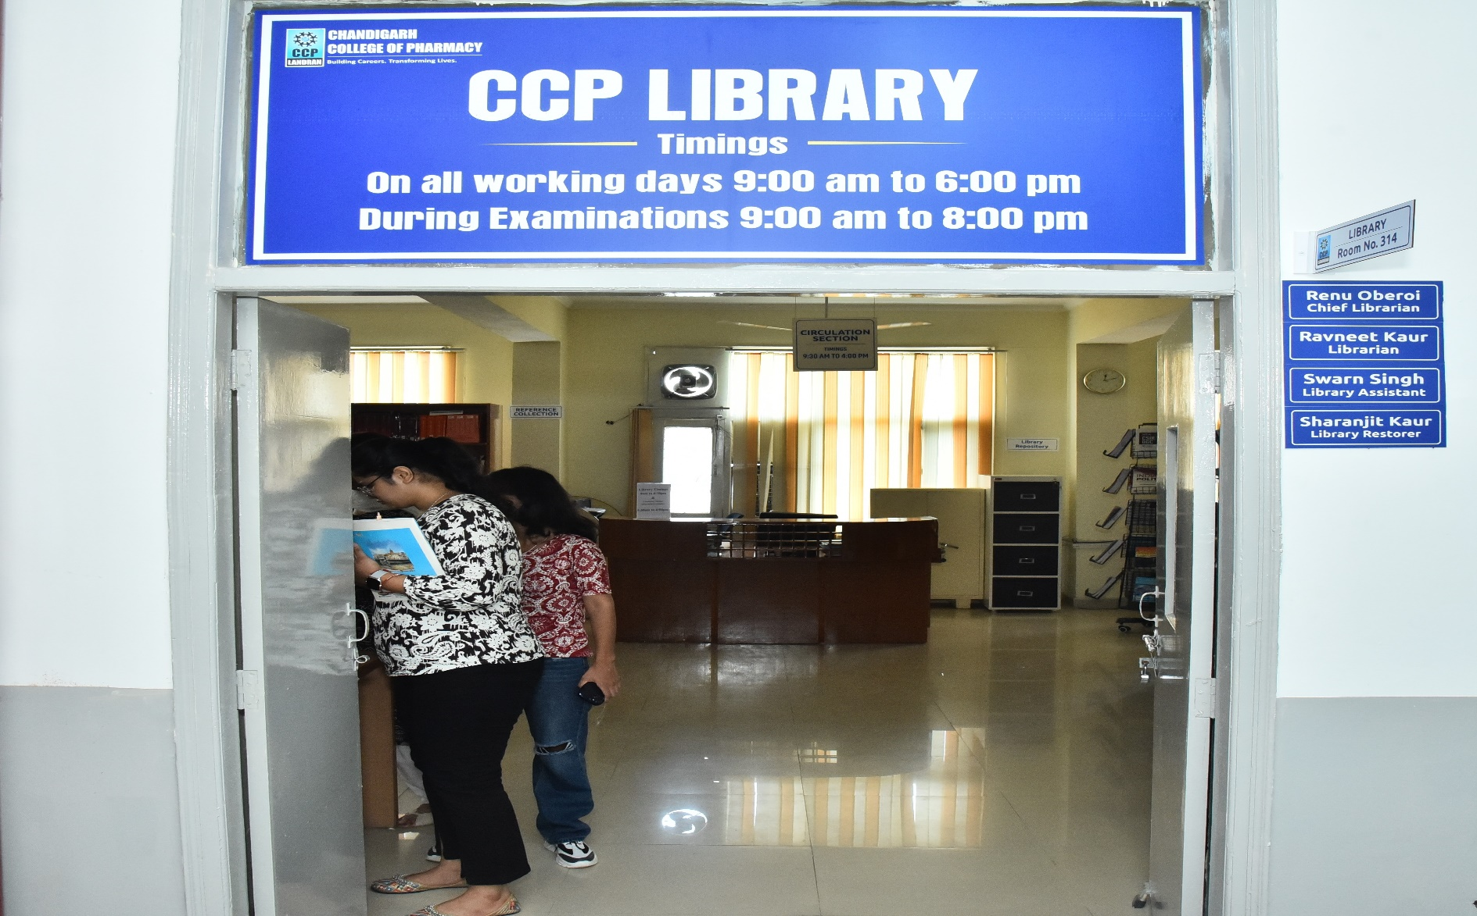
ENTRY / EXIT GATE

Slide 52
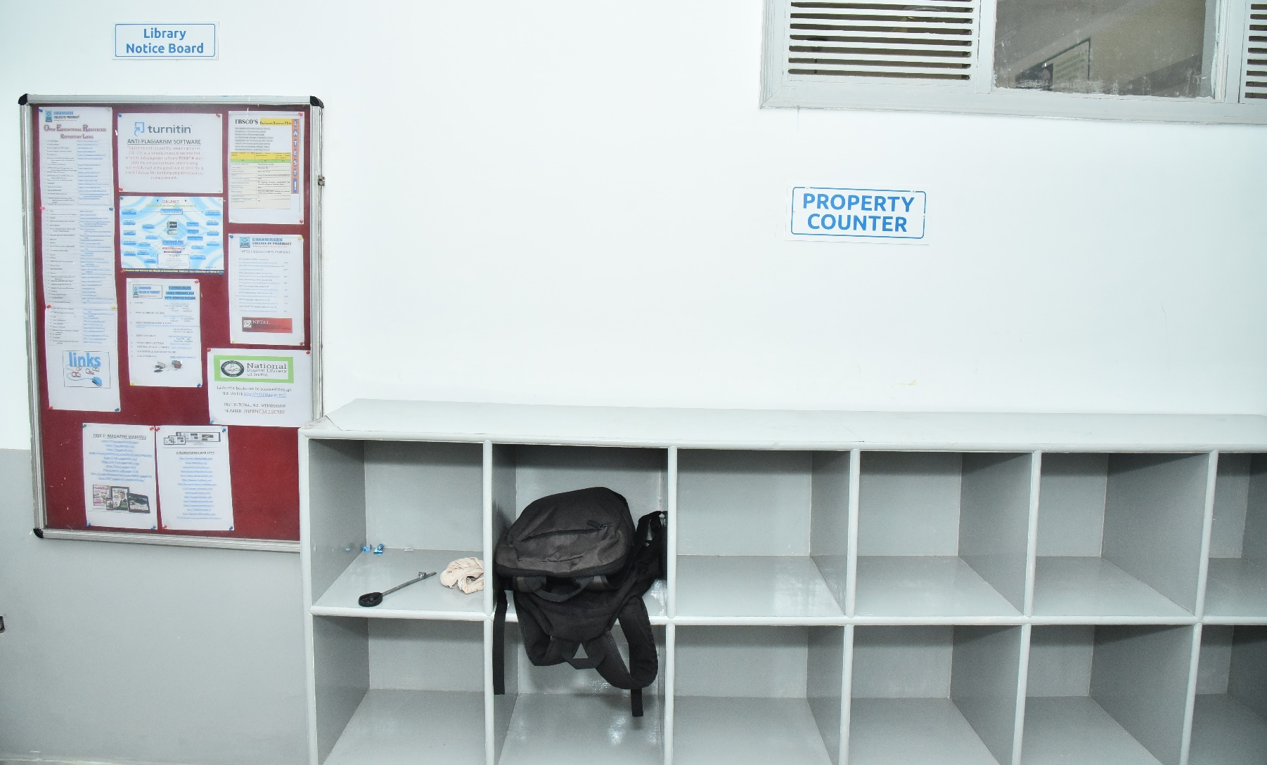
PROPERTY COUNTER

Slide 53
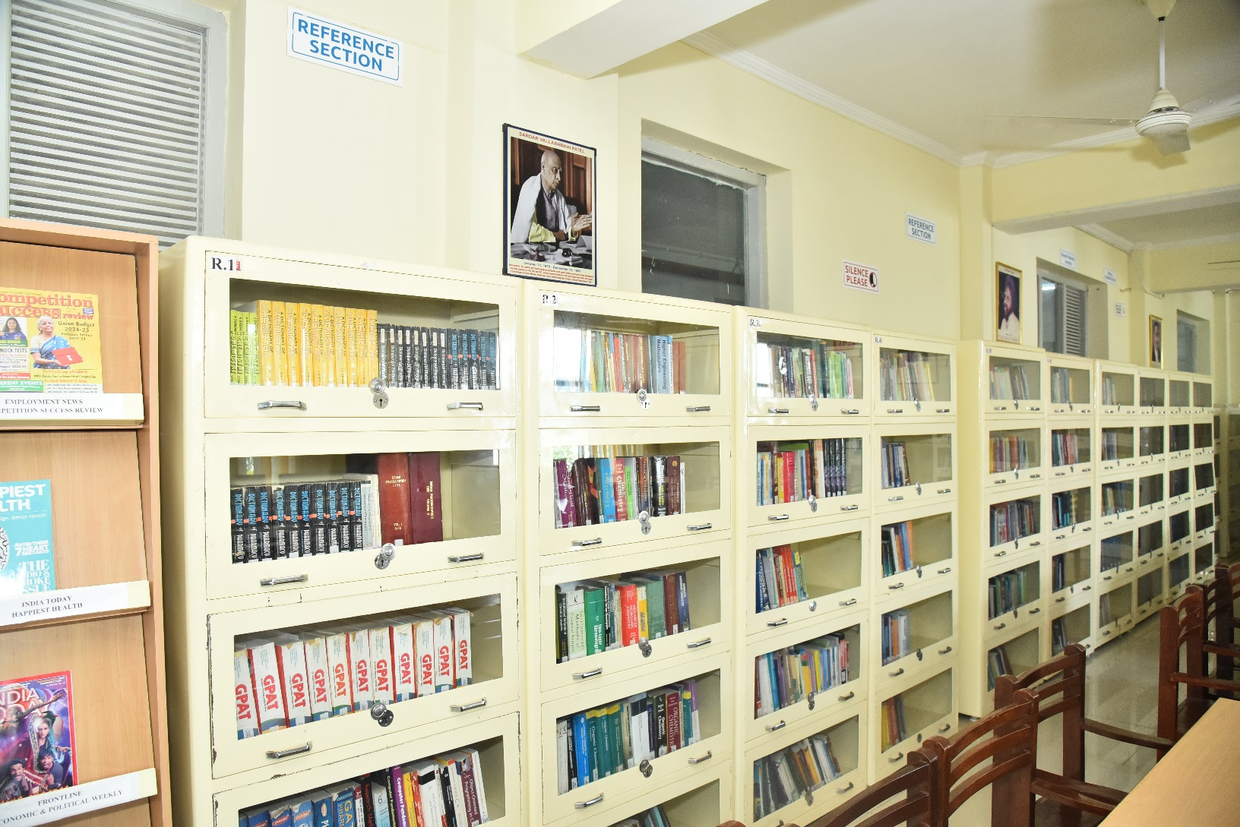
REFERENCE SECTION

Slide 54
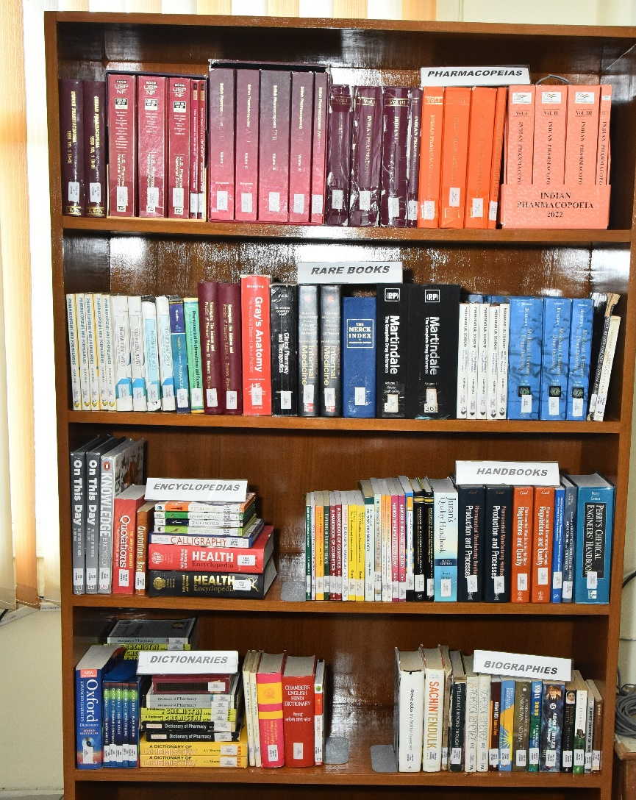
DISPLAY OF ENCYCLOPEDIA/ DICTIONARIES

Slide 55
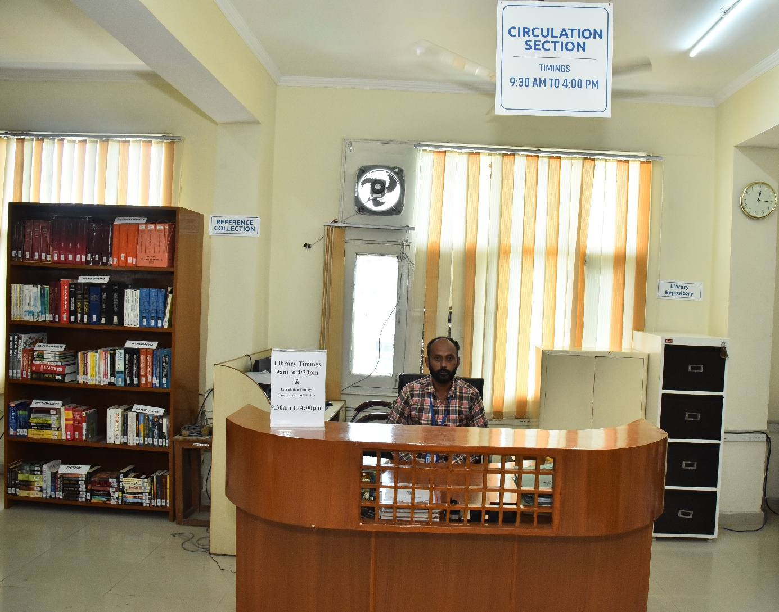
CIRCULATION SECTION

Slide 56
CIRCULATION SCHEDULE
NUMBER OF BOOKS ISSUED TO EACH STUDENT 3 BOOKS
PERIOD OF RETENTION 21 DAYS
MERITORIOUS/SC STUDENTS GET 2 BOOKS EXTRA
CIRCULATION TIMINGS
9:30 am to 4:00 pm
IMPORTANT: ALL THE STUDENTS GET CLEARED THEIR LIBRARY ACCOUNTS AT THE END OF EACH SEMESTER

Slide 57
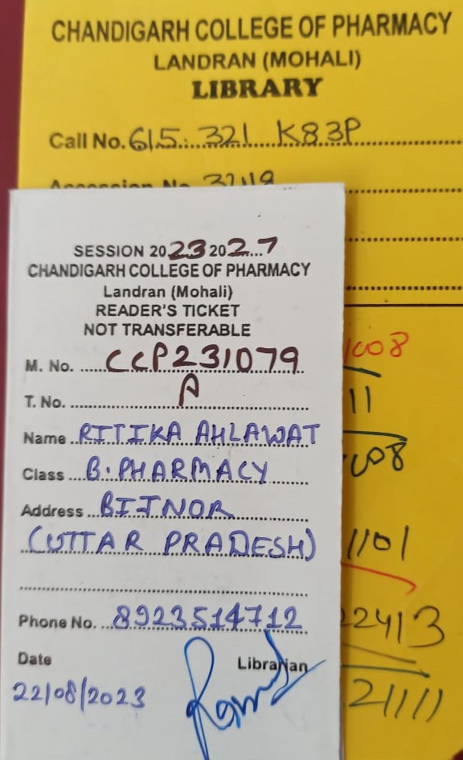
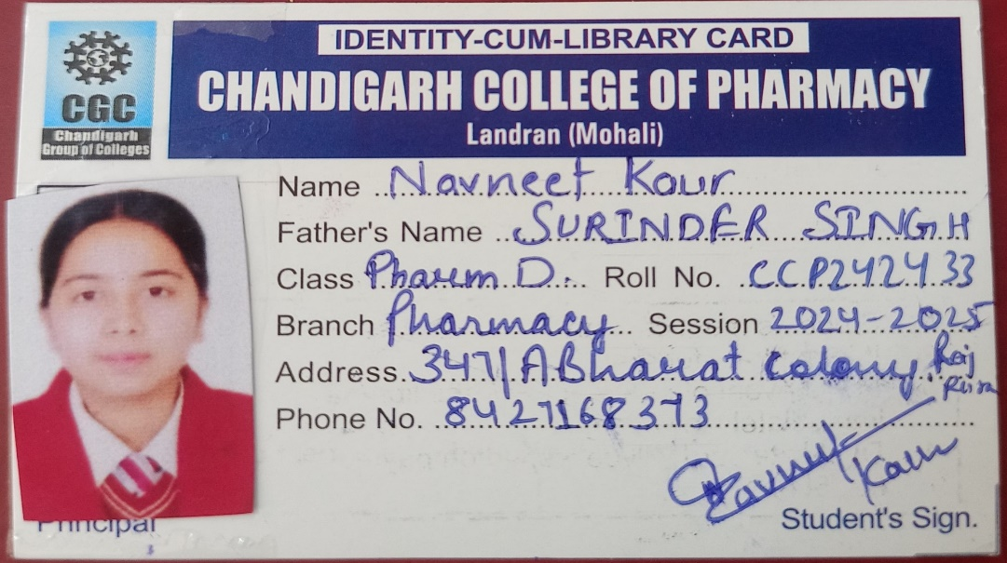
LIBRARY MEMBER ID CARD & READER TICKETS

Slide 58

STACK AREA

Slide 59
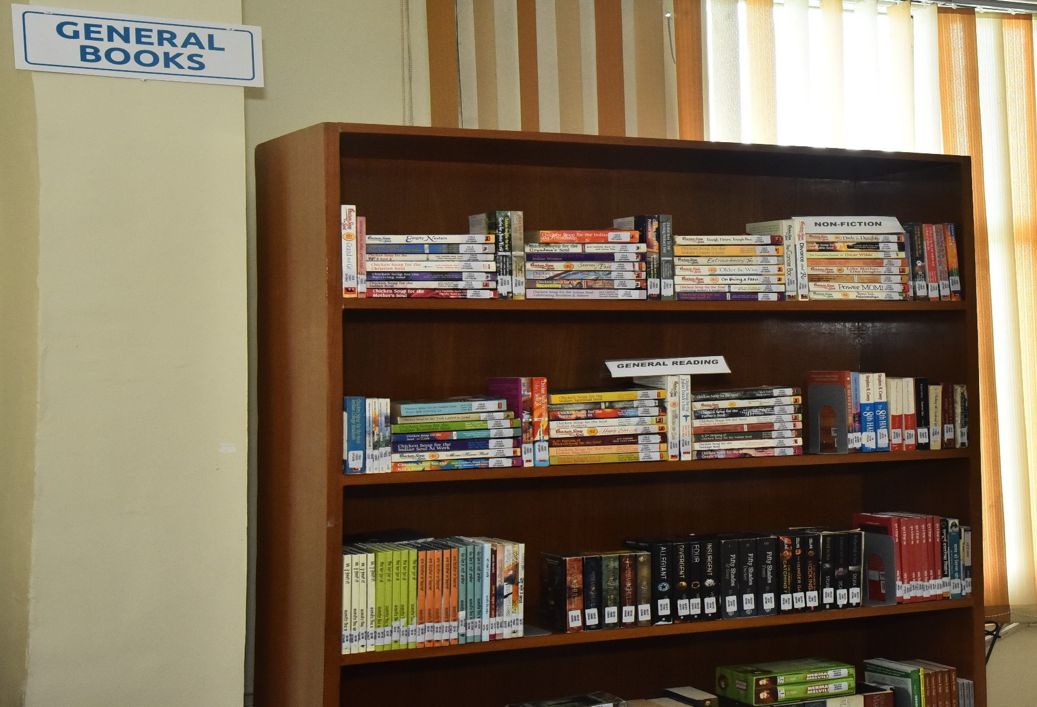
GENERALIA

Slide 60
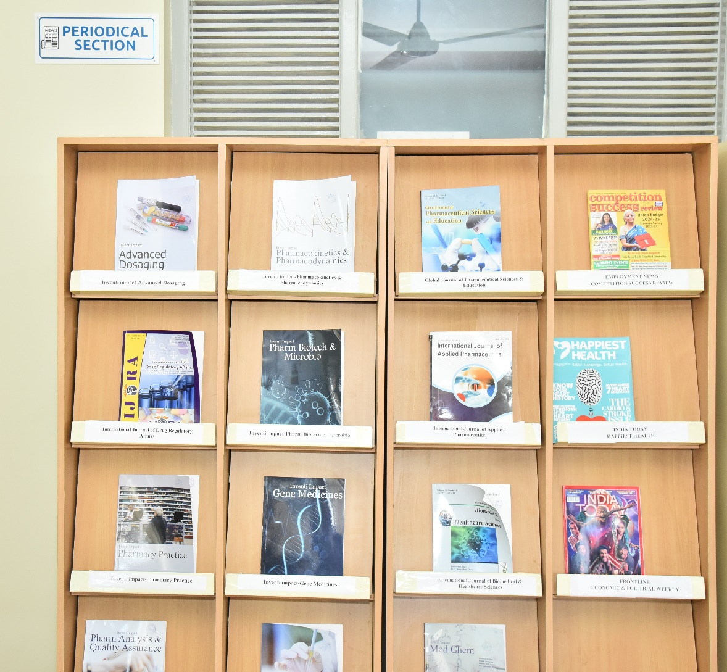
PERIODICAL SECTION
LIBRARY SUBSCRIBES TO 15 PRINT JOURNALS, 8 MAGAZINES AND 10 NEWSPAPERS

Slide 61
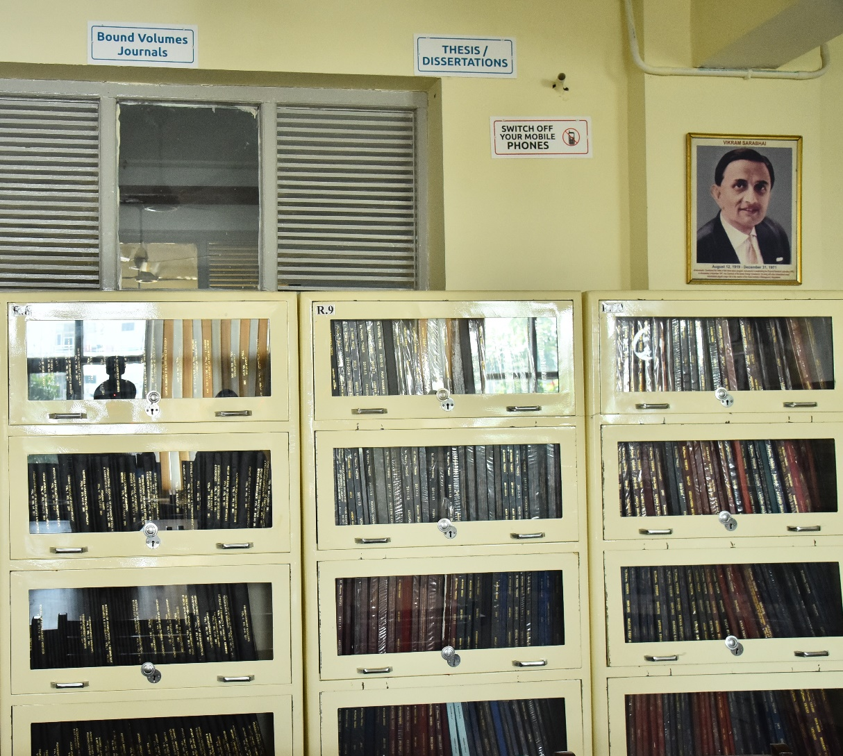
BOUND VOLUMES SECTION
JOURNALS till 2024

Slide 62
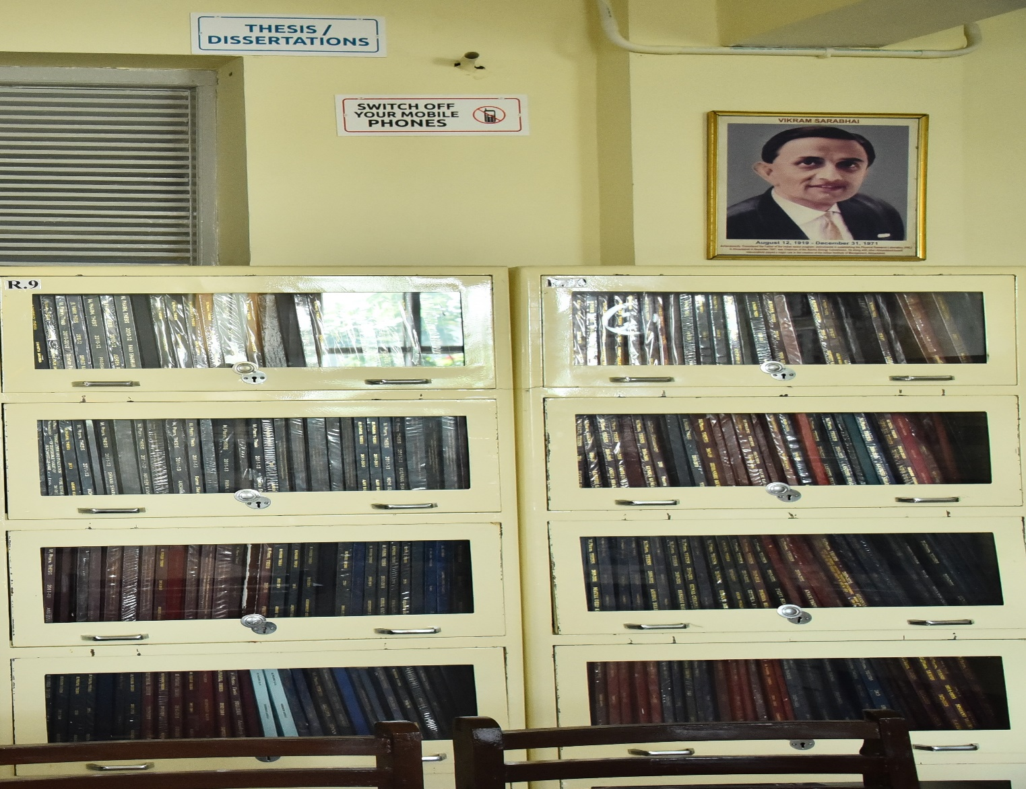
THESIS & DISSERTATIONS

Slide 63
LIST OF PRINT JOURNALS- YEAR 2026
JOURNAL | National/ INTL
INVENTI IMPACT-ADVANCED DOSAGING | NATIONAL
INVENTI IMPACT-BIOMEDICAL ANALYSIS | NATIONAL
INVENTI IMPACT-CLINICAL RESEARCH | NATIONAL
INVENTI IMPACT-GENE MEDICINES | NATIONAL
INVENTI IMPACT-MED-CHEM | NATIONAL
INVENTI IMPACT-PHARM ANALYSIS & QUALITY ASSURANCE | NATIONAL
INVENTI IMPACT-PHARM BIOTECH & MICROBIO | NATIONAL
INVENTI IMPACT-PHARMACOKINETICS & PHARMACODYNAMICS | NATIONAL
INVENTI IMPACT- PHARMACY PRACTICE | NATIONAL
INVENTI IMPACT-PHARM TECH | NATIONAL
INTERNATIONAL JOURNAL OF DRUG REGULATORY AFFAIRS | INTERNATIONAL
INTERNATIONAL JOURNAL OF PHARMACY & DRUG RESEARCH | INTERNATIONAL
GLOBAL JOURNAL OF PHARMACEUTICAL SCIENCES & EDUCATION | INTERNATIONAL
INTERNATIONAL JOURNAL OF BIOMEDICAL & HEALTHCARE SCIENCES | INTERNATIONAL
INTERNATIONAL JOURNAL OF APPLIED PHARMACEUTICS | INTERNATIONAL

Slide 64
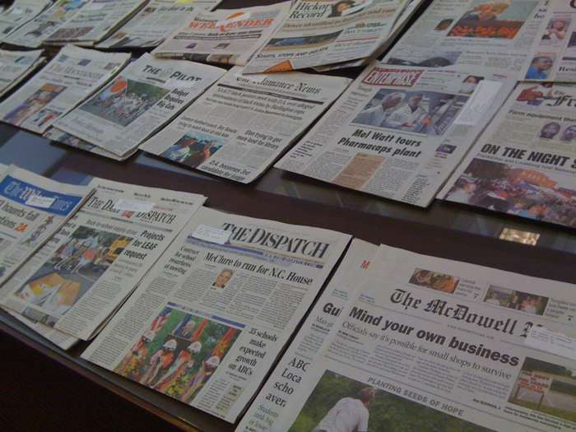

ENGLISH NEWSPAPERS
1. The Tribune
2. Hindustan Times
3. The Times of India
4. Indian Express
5. The Hindu
6. The Financial Express
7. Economic Times
HINDI NEWSPAPERS
8.Amar Ujala
9. Dainik Bhaskar
PUNJABI NEWSPAPERS
10. Jagbani

Slide 65
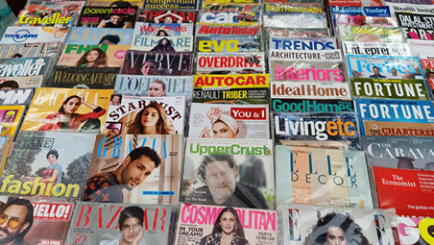
LIST OF MAGAZINES
INDIA TODAY (ENG.)
HAPPIEST HEALTH
BUSINESS TODAY
COMPETITION SUCCESS REVIEW
PRATIYOGITA DARPAN
THE WEEK
EMPLOYMENT NEWS
PC QUEST

Slide 66
CHANDIGARH COLLEGE OF PHARMACY - CGC
Library Rules
All students/users must observe total silence in the library and its environs at all times
All users/students are required to scan their College/Library ID Cards while entering the library. No one will be allowed to enter the Library without ID Card.
All students must present their Library ID Cards before borrowing any library material.

Slide 67
Library Rules CONTD.
In case of loss of ID and Reader’s Tickets, the duplicate ID card with DDR will be provided against Rs. 100/- and Readers’ Tickets against Rs.20/- each.
In case any book is lost or damaged by the borrower, he/she shall replace the latest issue of the book or set of books if one volume of the set is lost, or shall pay twice the cost of the book, within a period of 15 days, with delay fine if any.
Personal Books, Bags/ belongings, eatables, and mobile phone use are not allowed inside the library. A fine of Rs.100/- may be charged from the defaulters.

Slide 68
Library Rules CONTD.
The students/users are required to maintain discipline and silence within the library premises. In case of indiscipline, the Library Membership will be cancelled.
The students/users cannot take any book, magazine, or newspaper, outside the library without permission.
The Circulation Timing will strictly be between 9:30 AM to 4:00 PM without any break, on all working days.
The students will be issued 3 books against 3 Reader’s Tickets at a time, for a period of 21 days. The books in demand will be issued for 7 days.
All students have to return all the library books issued against their names before the start of the new semester

Slide 69
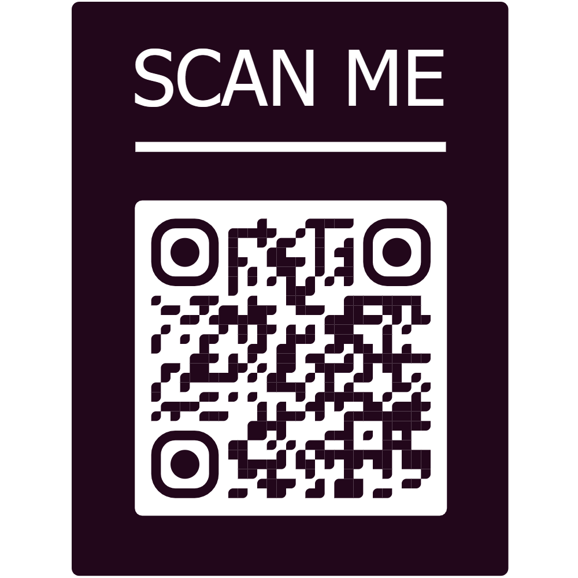
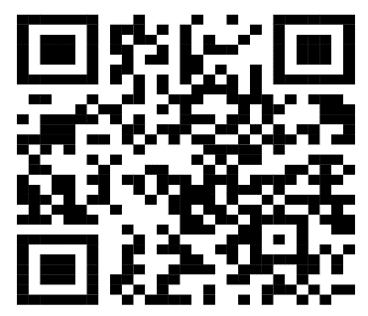
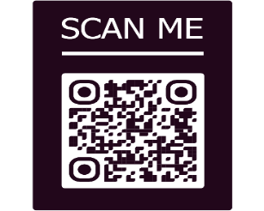
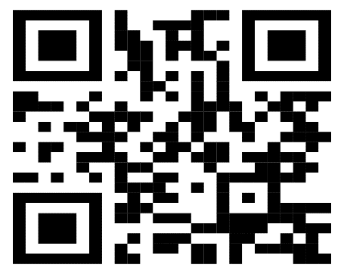

CCP LIBRARY NEWSLETTER PHARMAFLAIR
ISSUE 1ST
DECEMBER 2023
ISSUE 3RD
SEPTEMBER 2024
ISSUE 2ND
APRIL 2024
ISSUE 4TH
SEPTEMBER 2025
ISSUE 5TH
APRIL 2026

Slide 70

FOR ANY QUERY / SUGGESTION CONTACT :
Renu Oberoi
Chief Librarian
Chandigarh College of Pharmacy, Landran
0172-3984229
8872014309
chief.librarian@cgc.edu.in
ANY SUGGESTION PLEASE

Slide 71

Ready to HELP YOU.
THANK YOU

